Slide 1
University of Nottingham FYP Presentation
March 2024

Slide 2
Goal: Classification of Emotions using Heart Signals on ARM Cortex-M

Slide 3
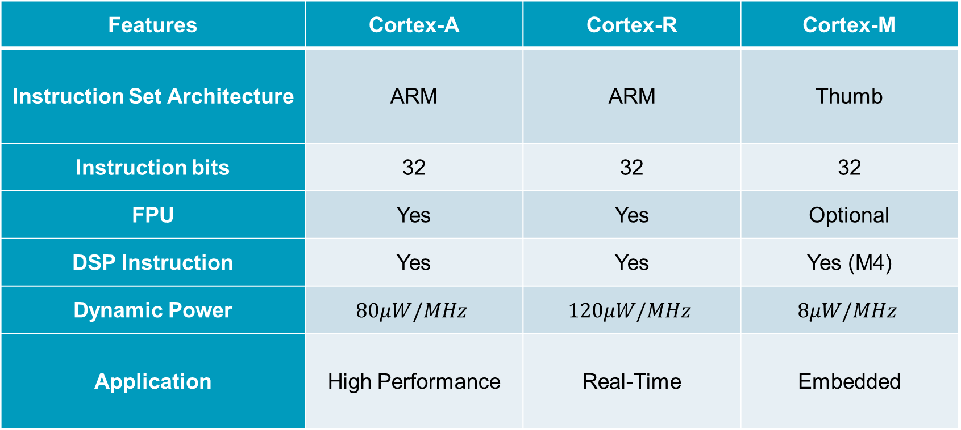
Comparison Between ARM Processors
Features | Cortex-A | Cortex-R | Cortex-M
Instruction Set Architecture | ARM | ARM | Thumb
Instruction bits | 32 | 32 | 32
FPU | Yes | Yes | Optional
DSP Instruction | Yes | Yes | Yes (M4)
Dynamic Power | $$80μW/MHz$$ | $$120μW/MHz$$ | $$8μW/MHz$$
Application | High Performance | Real-Time | Embedded

Slide 4
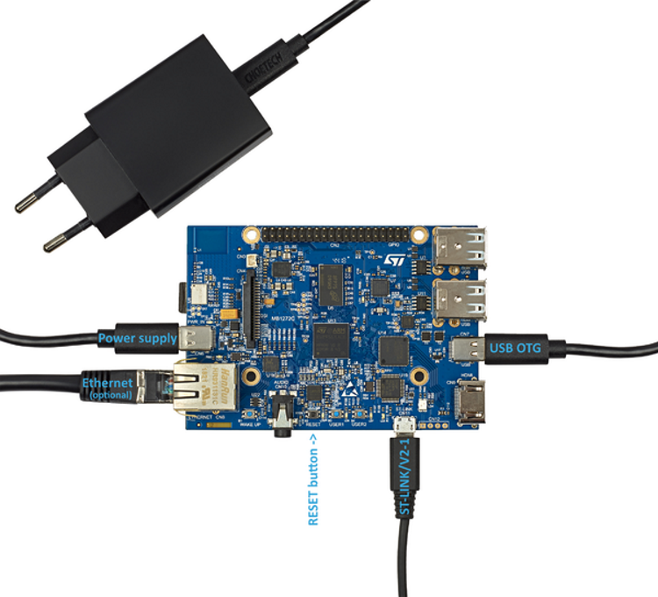
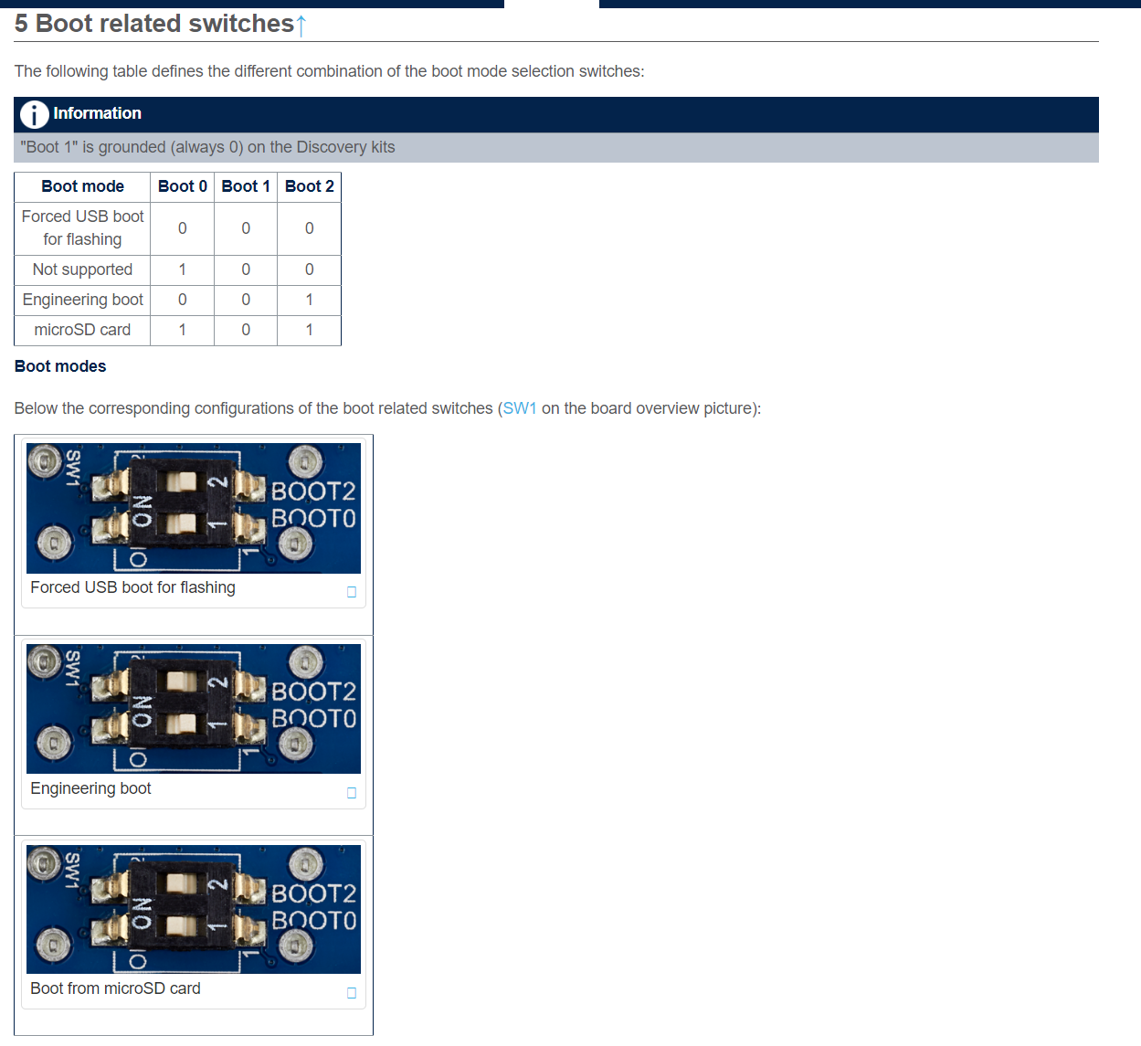
Setting Up STM32CubeIDE & Testing Code
Requirements
5V 3A power supply is needed
ST-Link used as a debugger connection
Engineering Mode/Boot Mode

Slide 5
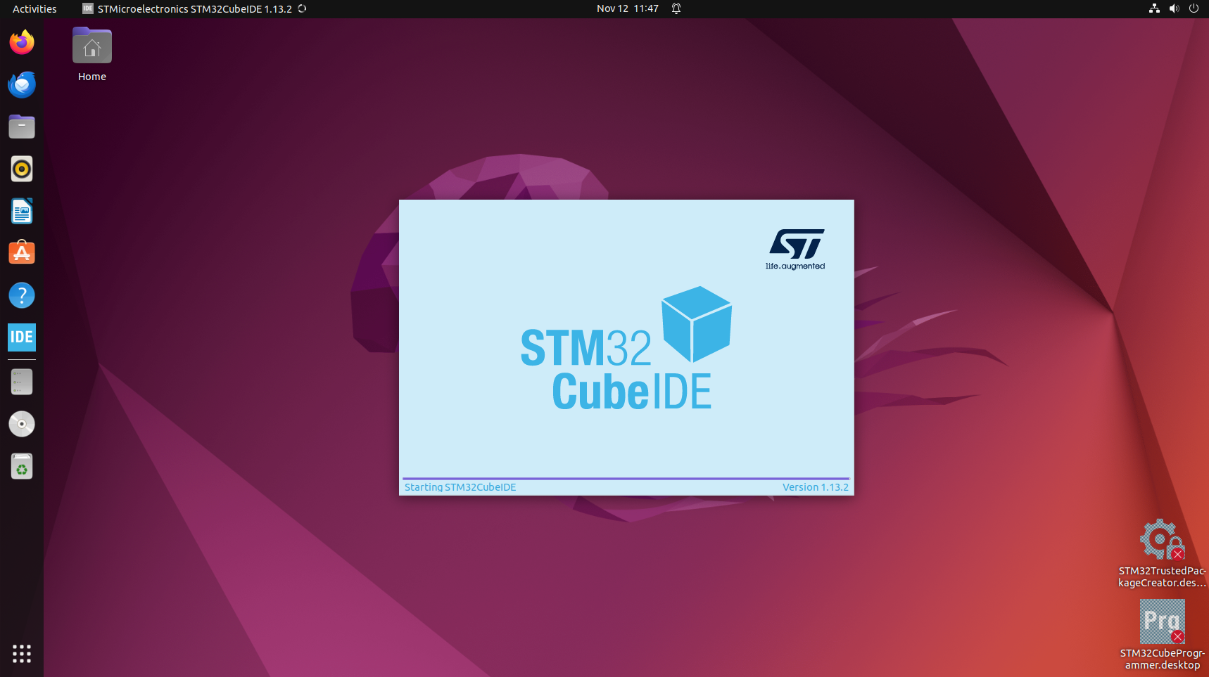
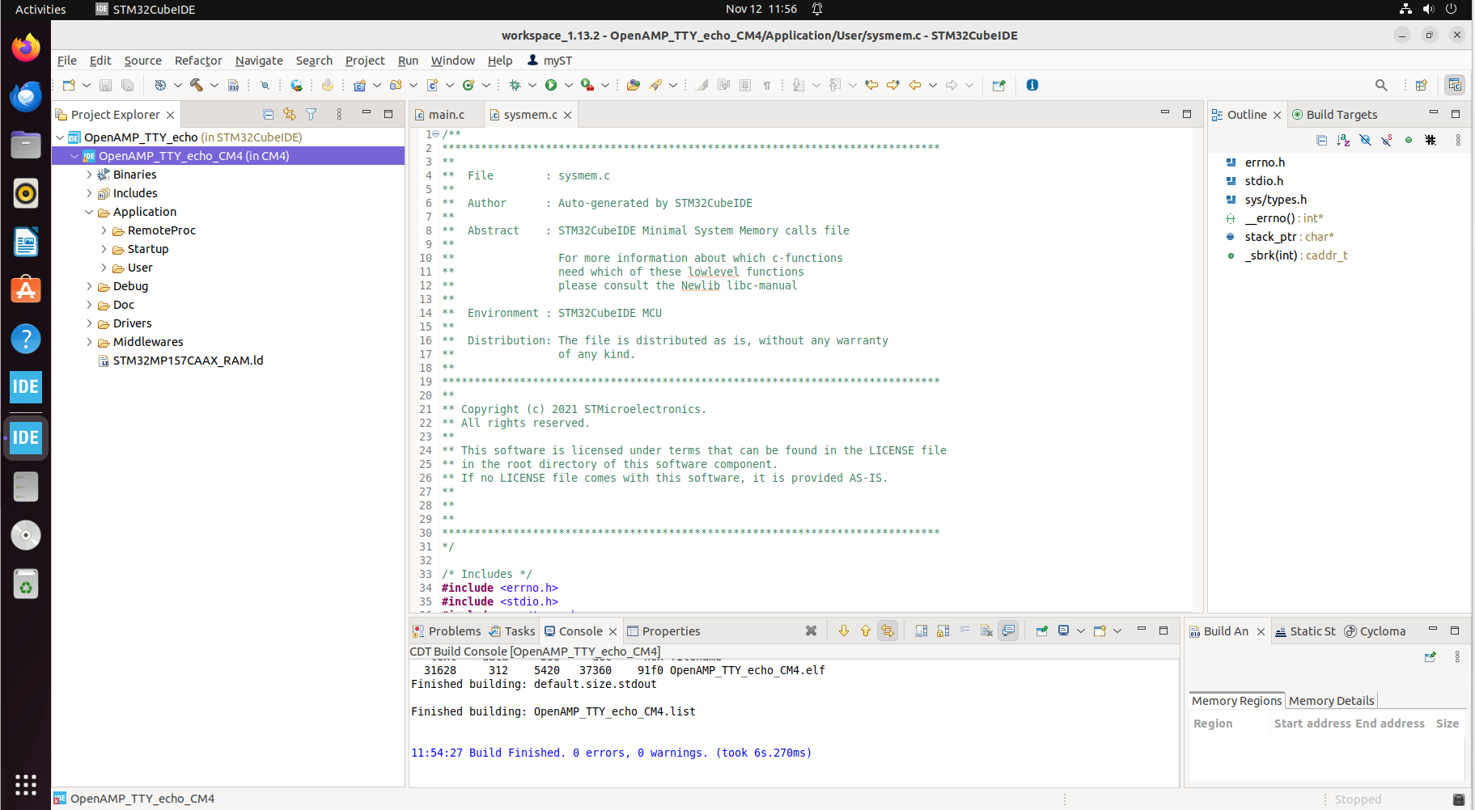
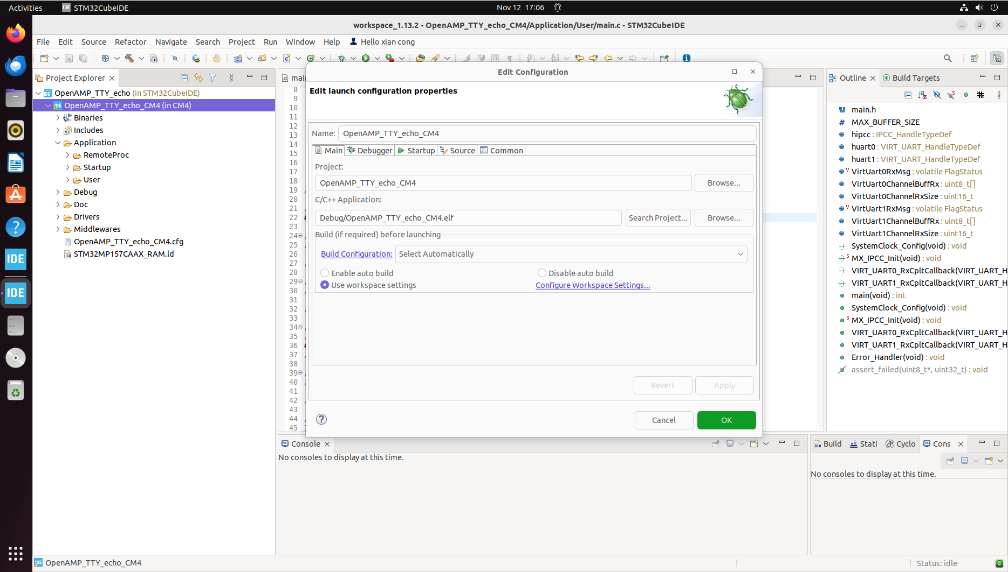
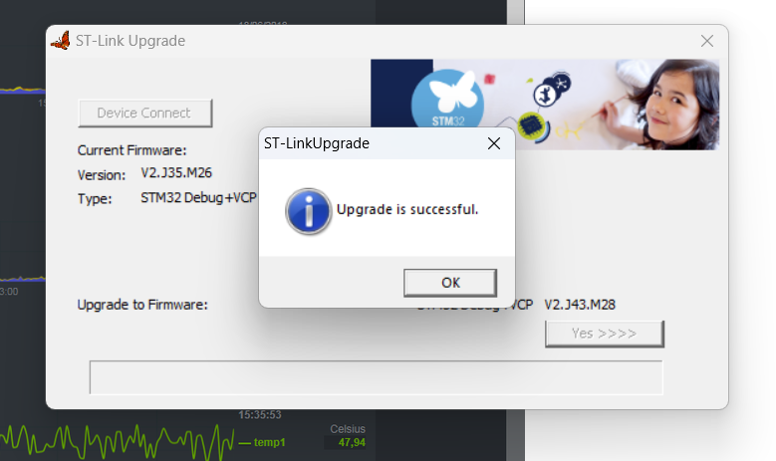
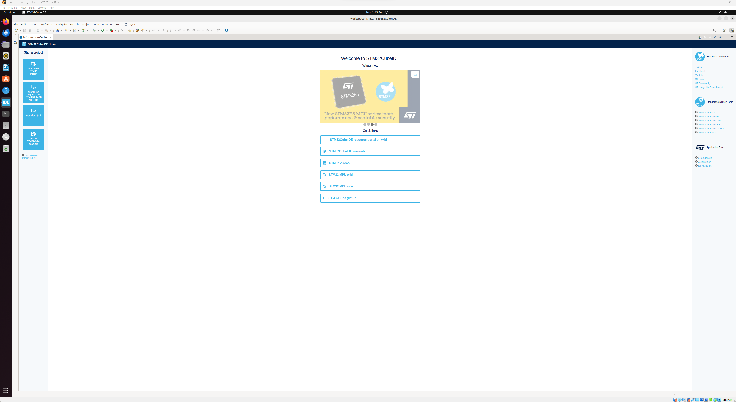
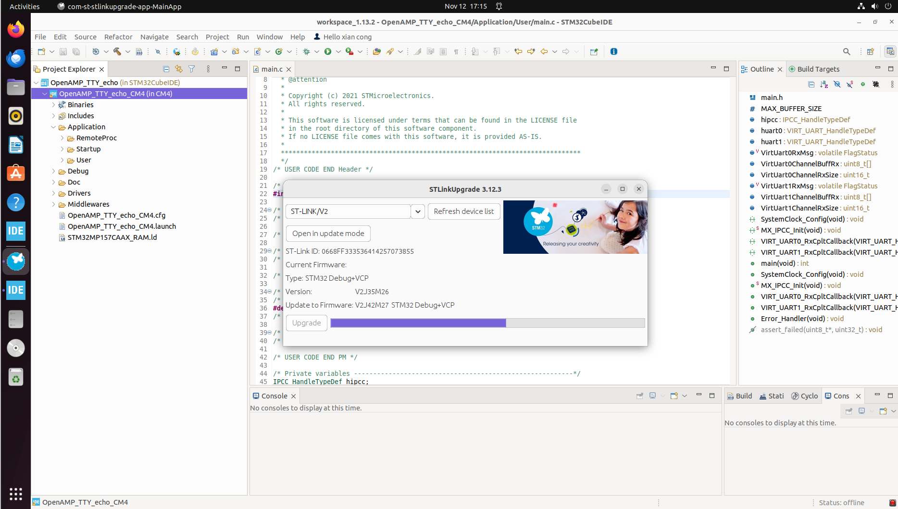
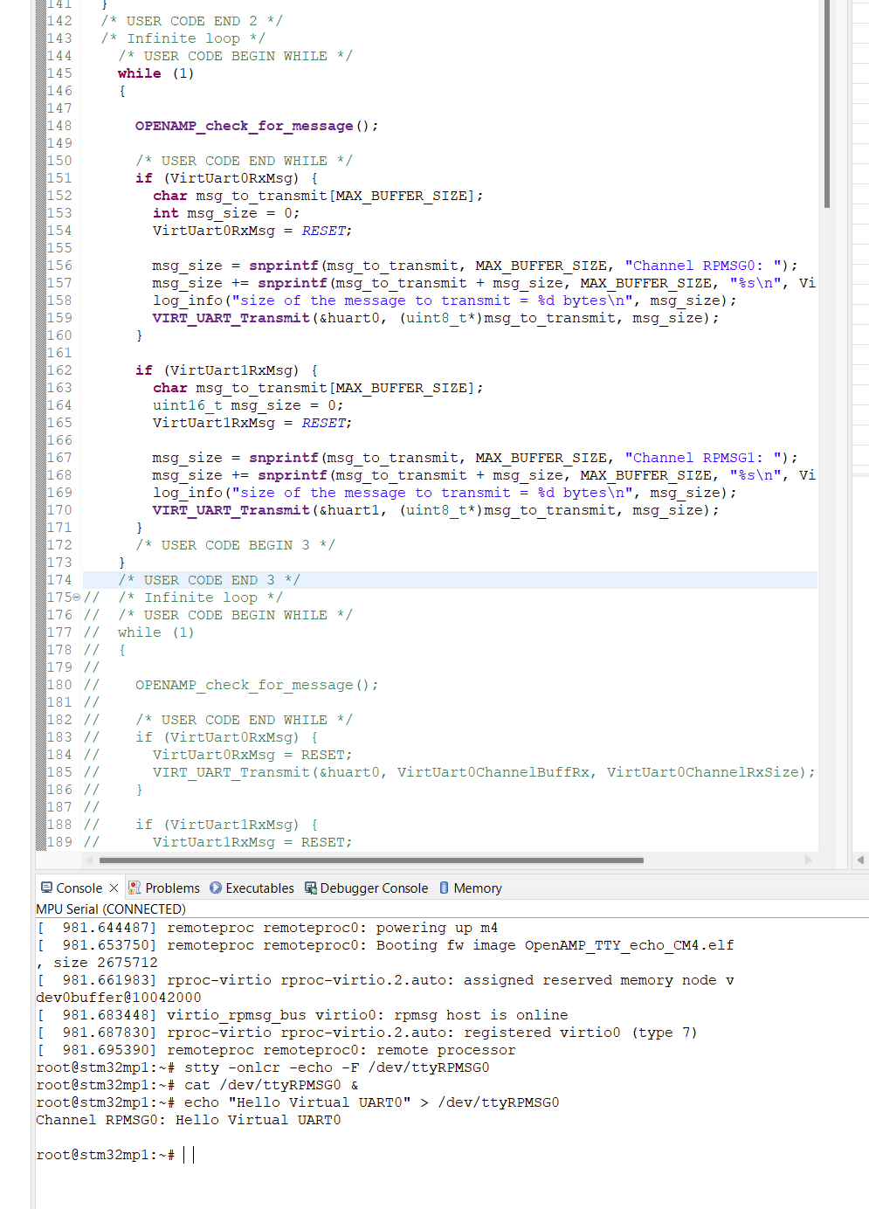
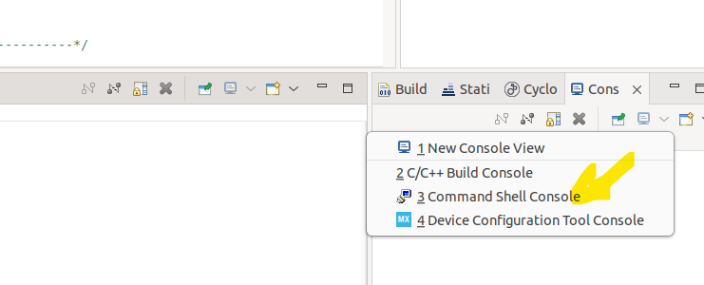
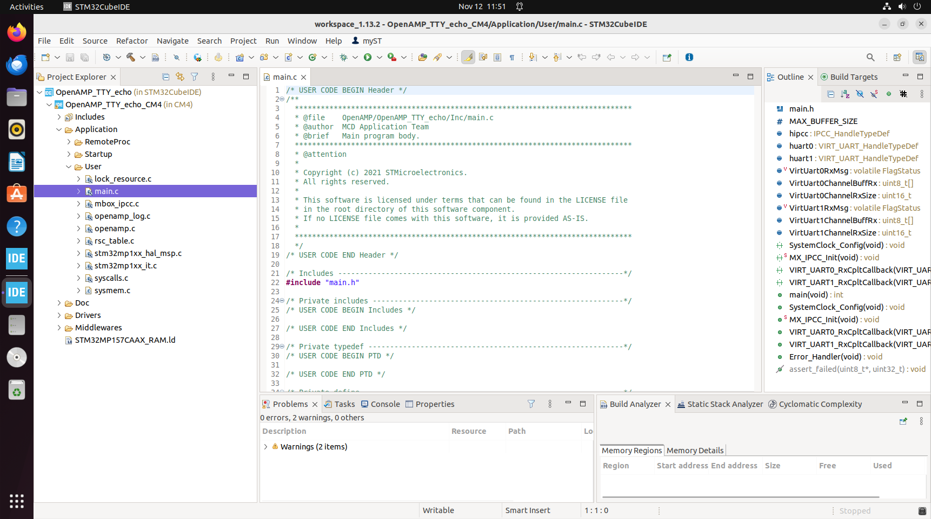
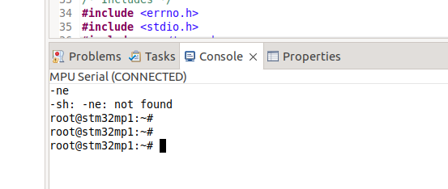
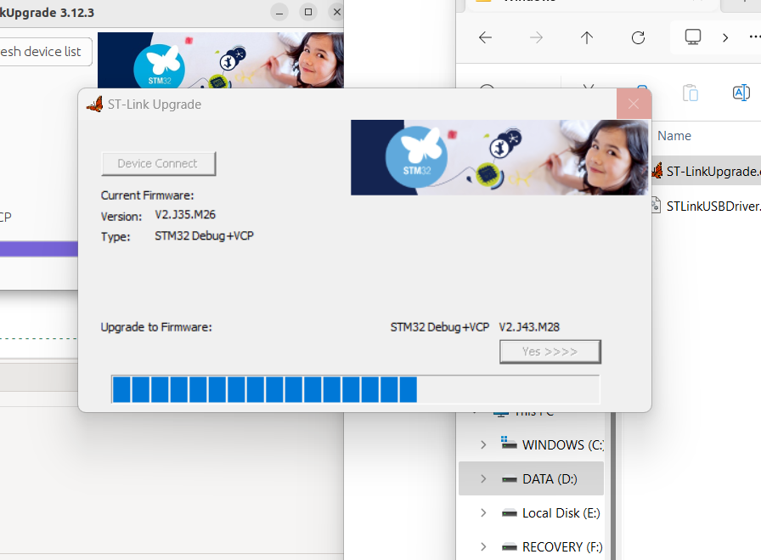
Setting Up STM32CubeIDE & Testing Code

Slide 6
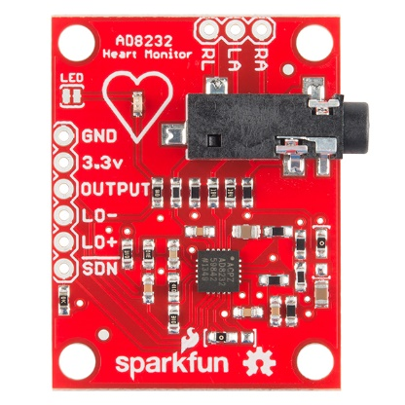
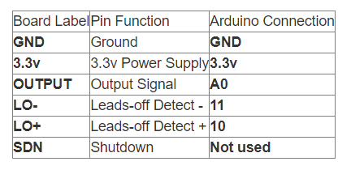
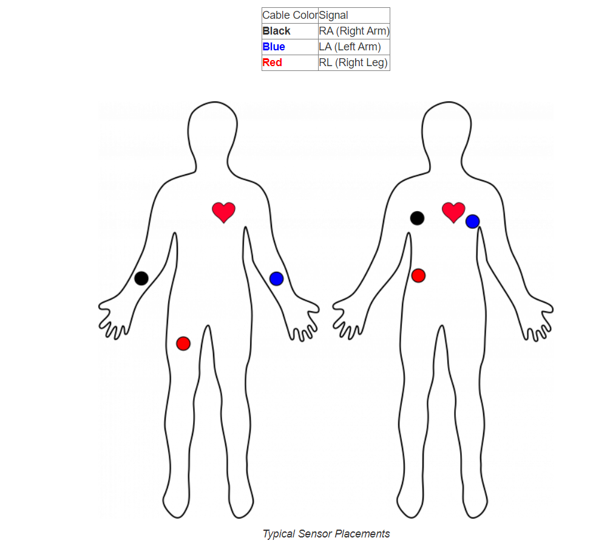
Connecting ECG sensors onto STM32MP157F-DK2
void setup() {
Serial.begin(9600);
pinMode(10, INPUT); // Setup for leads off detection LO +
pinMode(11, INPUT); // Setup for leads off detection LO -
}
void loop() {
if((digitalRead(10) == 1)||(digitalRead(11) == 1)){
Serial.println('!');
}
else{
// send the value of analog input 0:
Serial.println(analogRead(A0));
}
//Wait for a bit to keep serial data from saturating
delay(1);
}

Slide 7
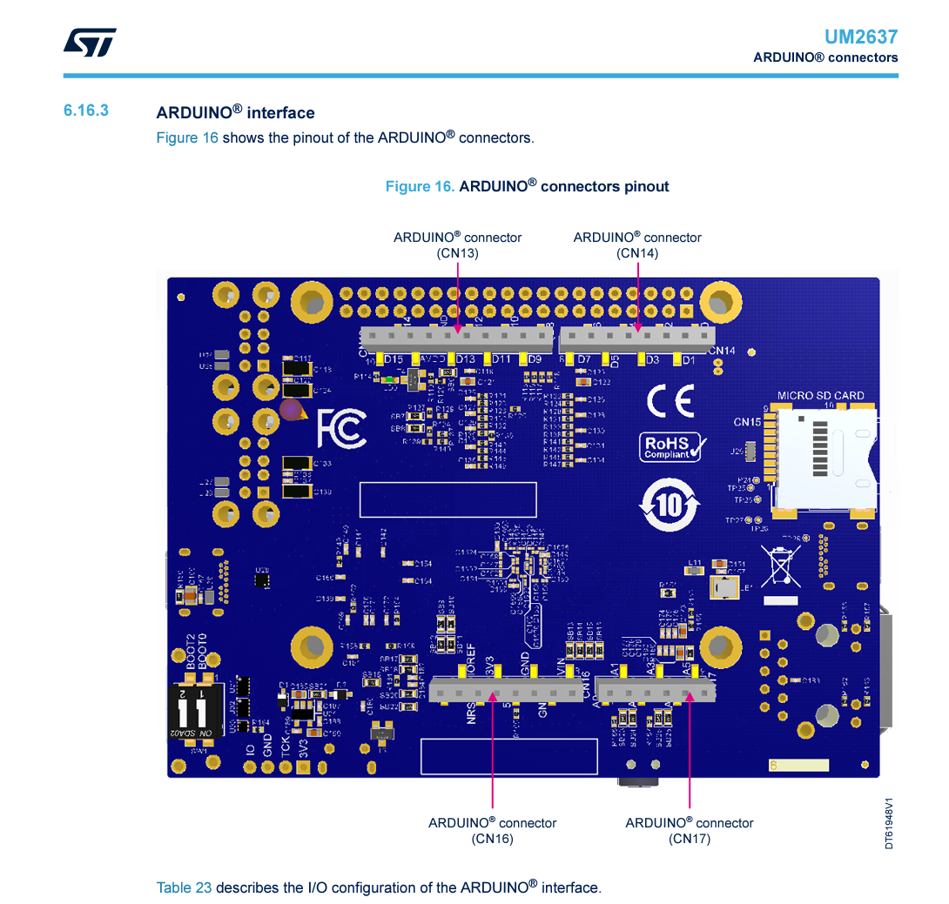
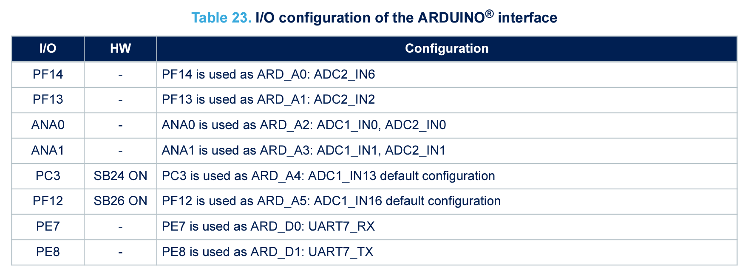
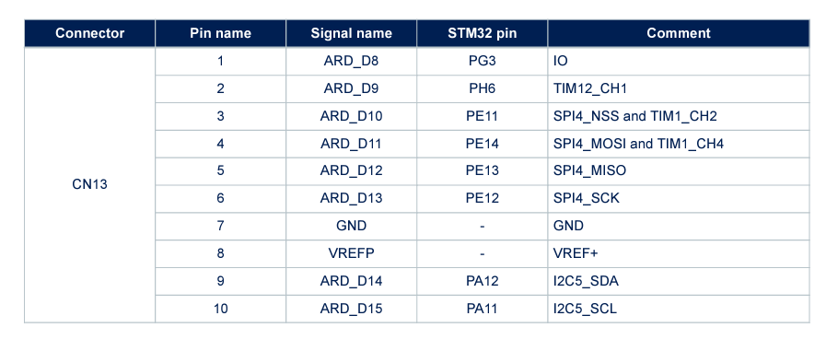
Connecting ECG sensors onto STM32MP157F-DK2

Slide 8
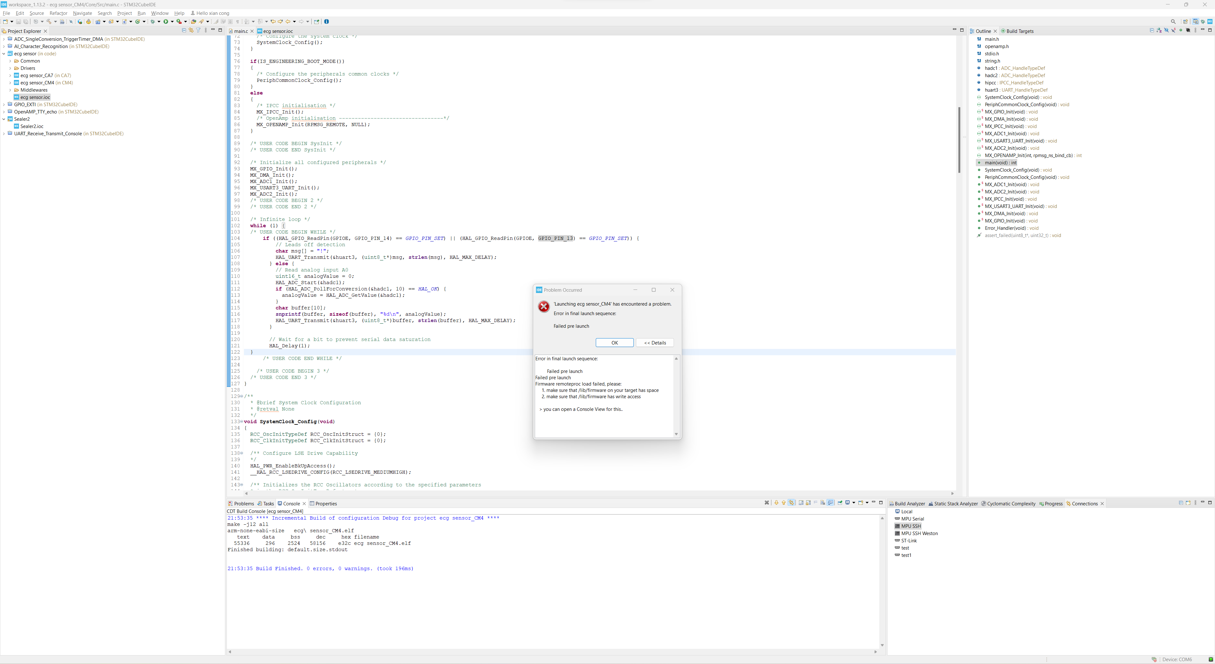
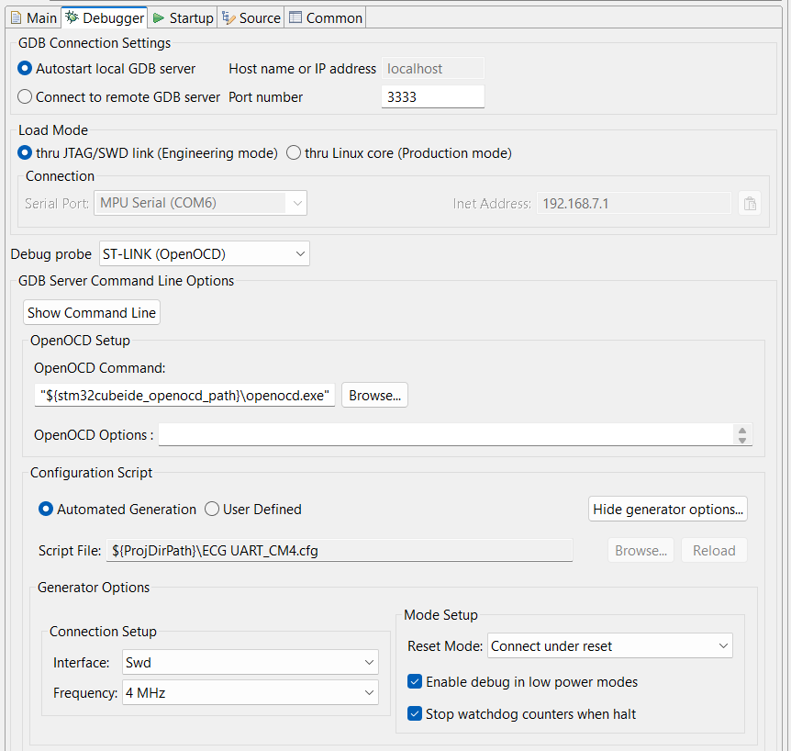
Problems

Slide 9
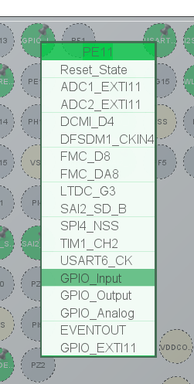
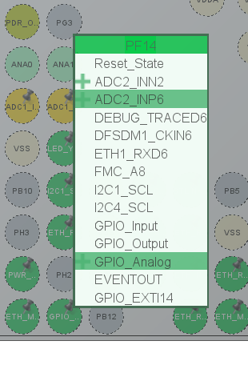
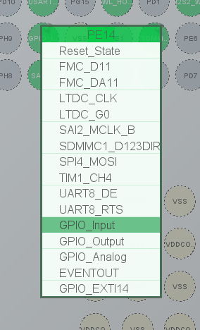
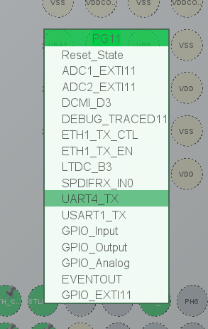
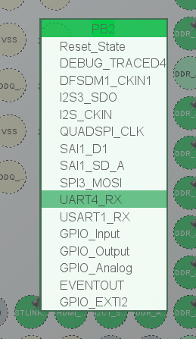
STM32 Pin Configuration
ADC
LO-
LO+
ST-Link UART

Slide 10
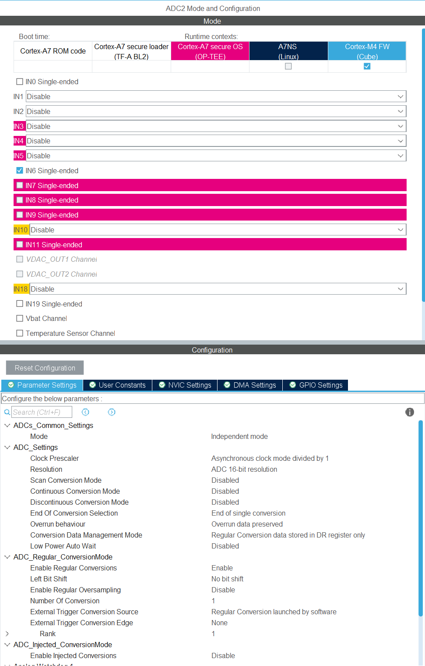
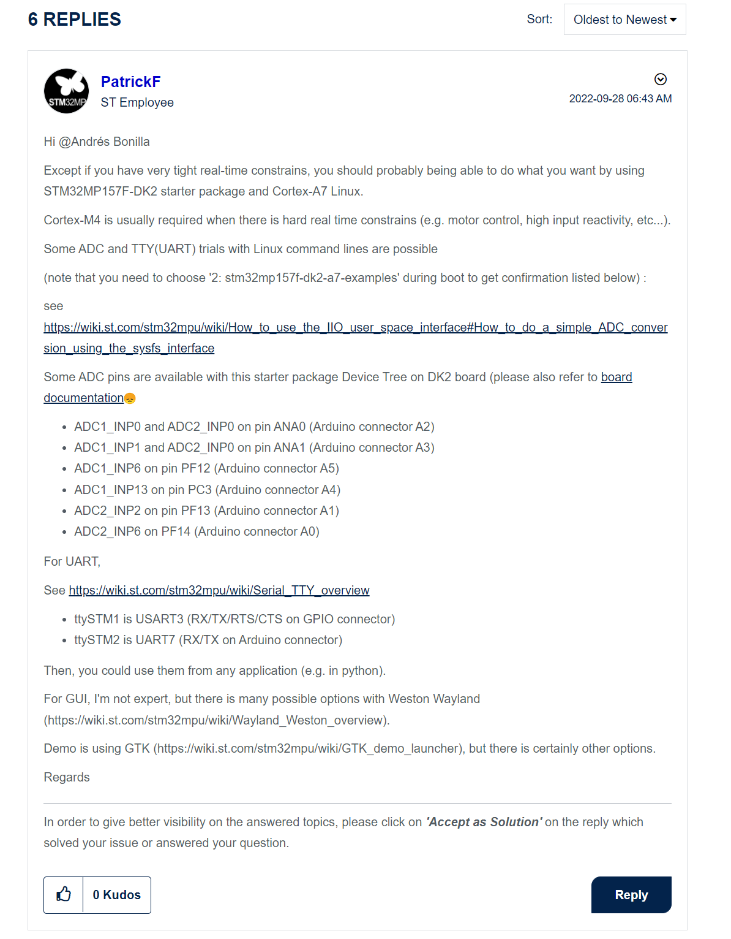
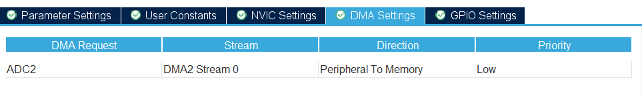
ADC

Slide 11
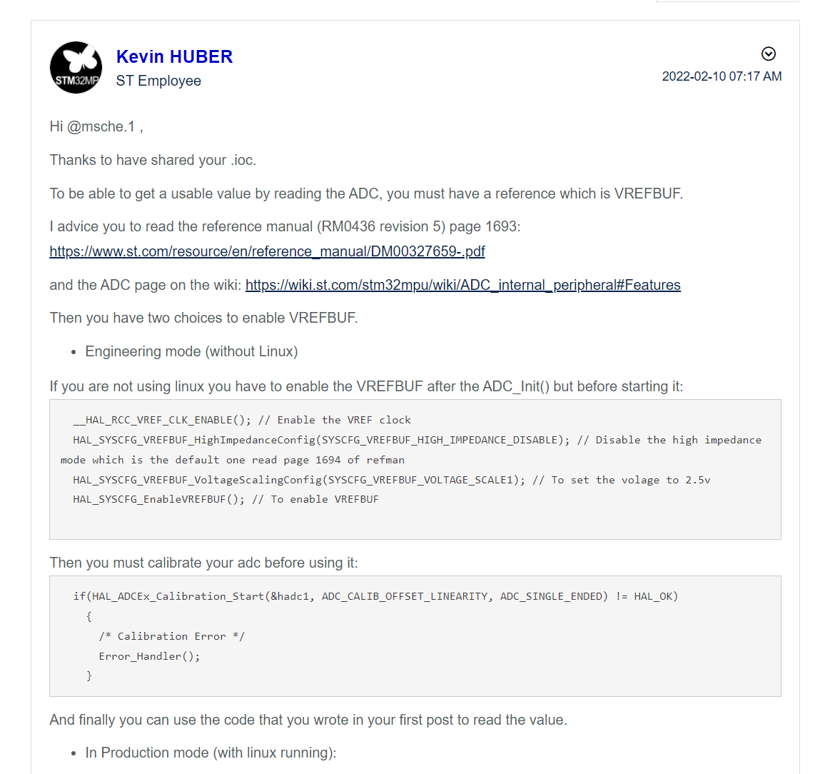
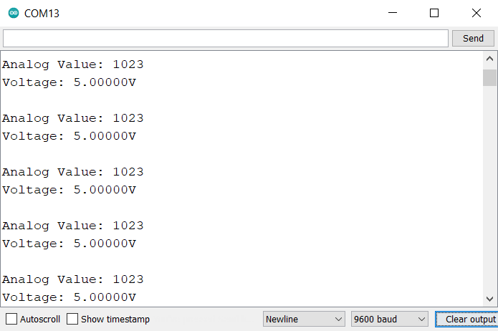
Problem

Slide 12
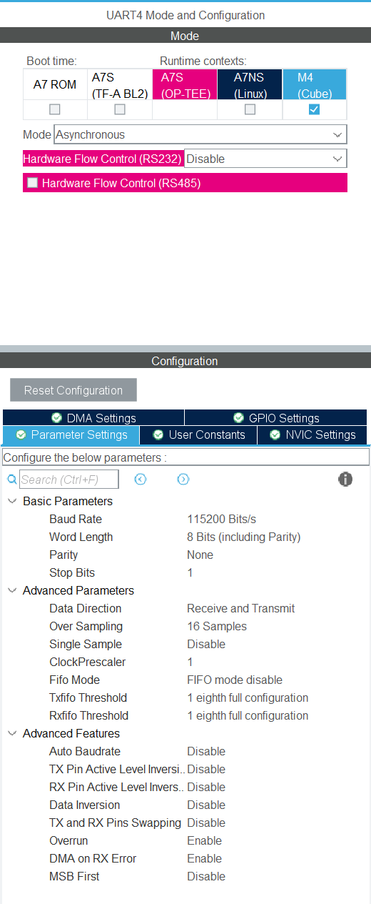
UART

Slide 13
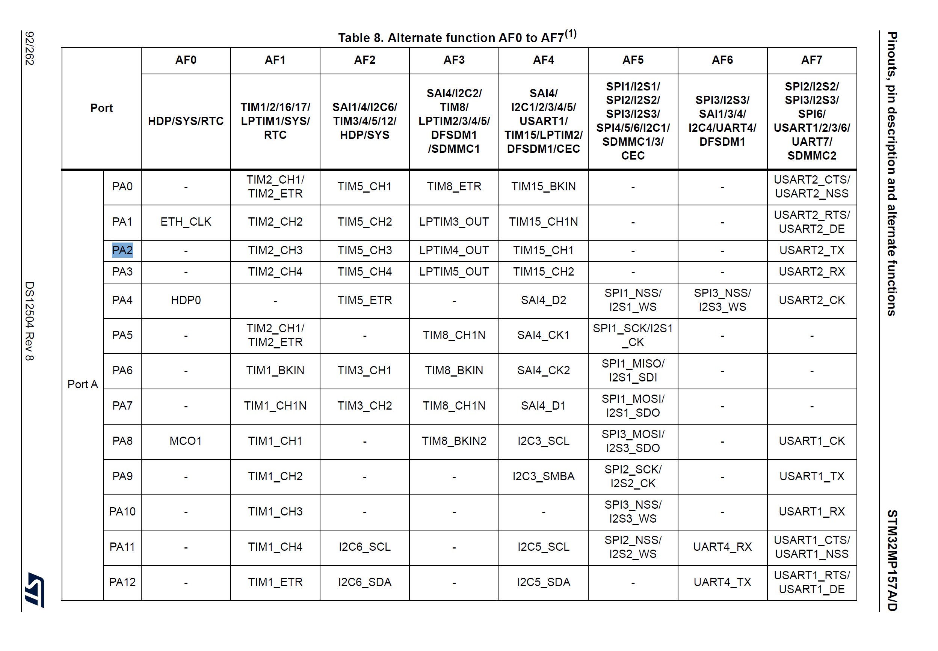
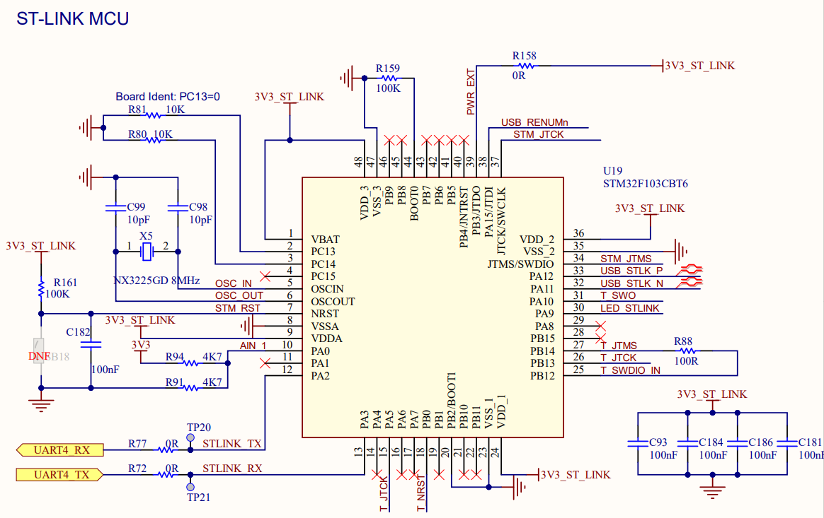
Problems

Slide 14
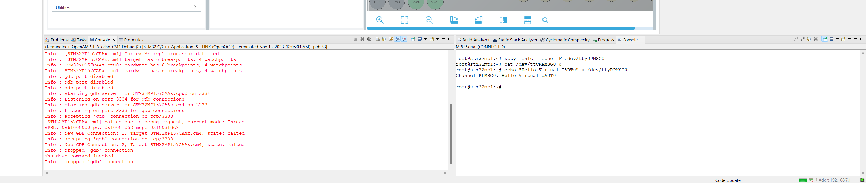
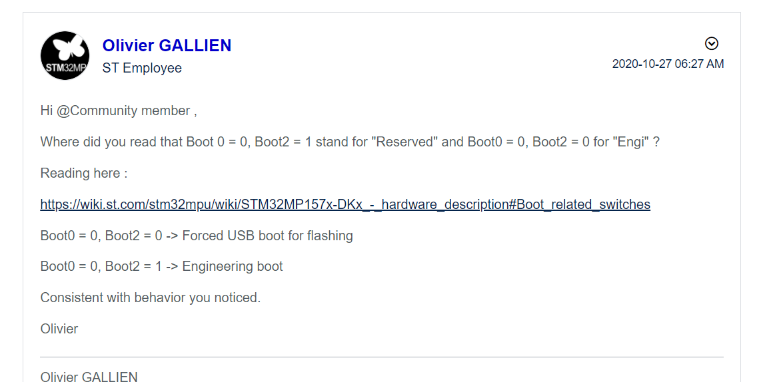
Problems

Slide 15
Code – Printing ADC values via ST-Link
while (1)
{
HAL_ADC_Start(&hadc2);
HAL_ADC_PollForConversion(&hadc2, HAL_MAX_DELAY);
raw = HAL_ADC_GetValue(&hadc2);
HAL_Delay(10);
sprintf(msg, "%d\r\n", raw);
HAL_UART_Transmit(&huart4, msg, strlen(msg), HAL_MAX_DELAY);
}

Slide 16
Code – Printing ADC values via ST-Link
__HAL_RCC_VREF_CLK_ENABLE(); // Enable the VREF clock
HAL_SYSCFG_VREFBUF_HighImpedanceConfig(SYSCFG_VREFBUF_HIGH_IMPEDANCE_DISABLE); // Disable the high impedance mode which is the default one read page 1694 of refman
HAL_SYSCFG_VREFBUF_VoltageScalingConfig(SYSCFG_VREFBUF_VOLTAGE_SCALE1); // To set the volage to 2.5v
HAL_SYSCFG_EnableVREFBUF(); // To enable VREFBUF
if(HAL_ADCEx_Calibration_Start(&hadc2, ADC_CALIB_OFFSET_LINEARITY, ADC_SINGLE_ENDED) != HAL_OK)
{
/* Calibration Error */
Error_Handler();
}

Slide 17
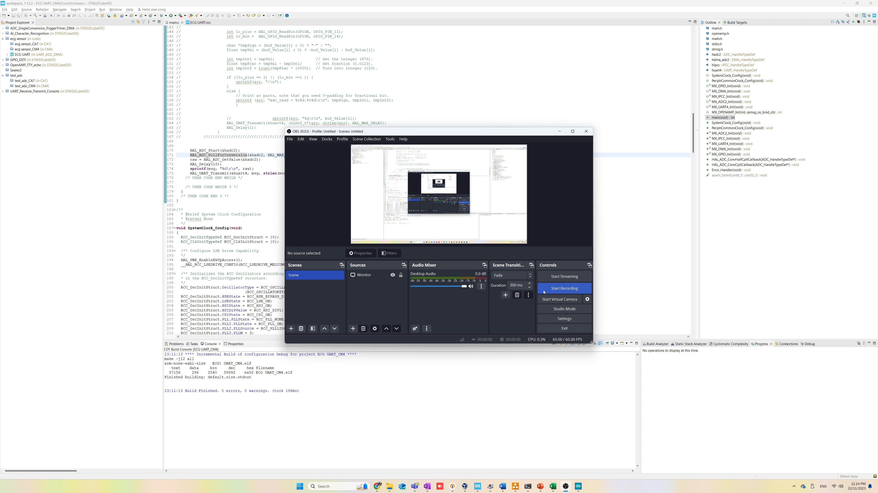
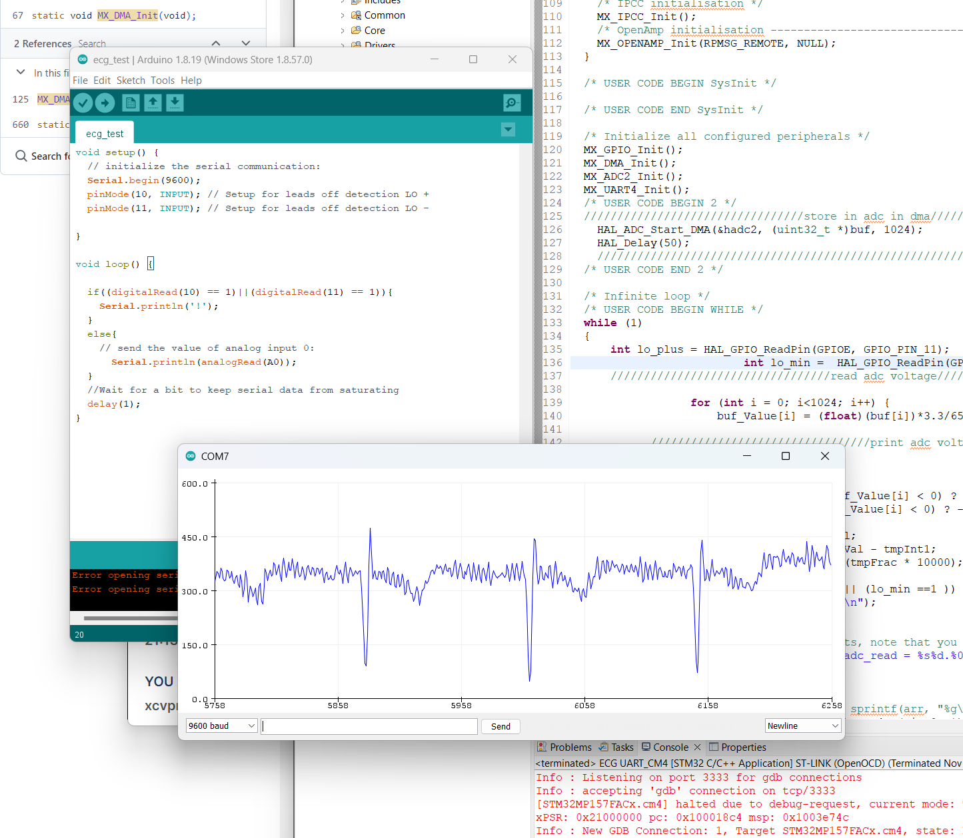
Result
https://youtu.be/zIlDBF6tEII

Slide 18
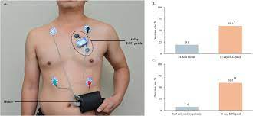
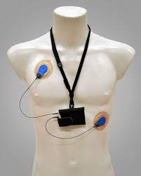
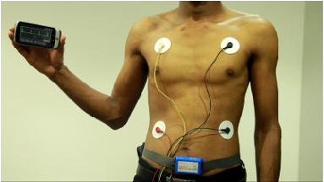
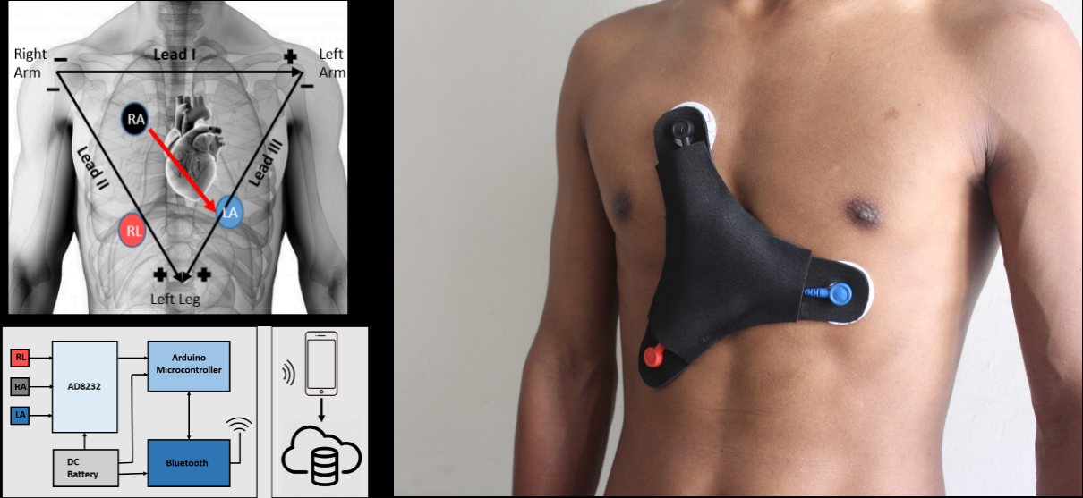
Wearable Design – Reference

Slide 19
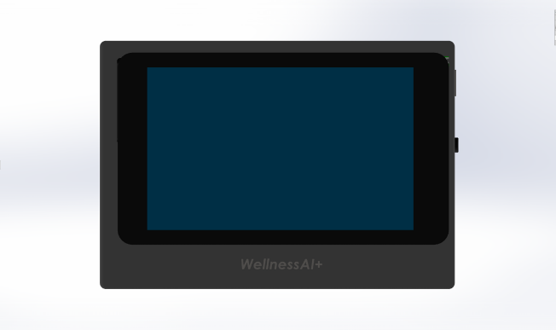
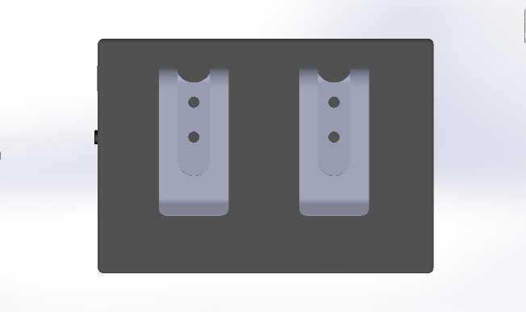
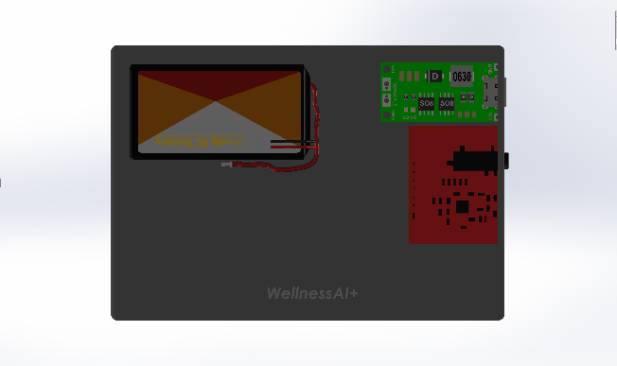
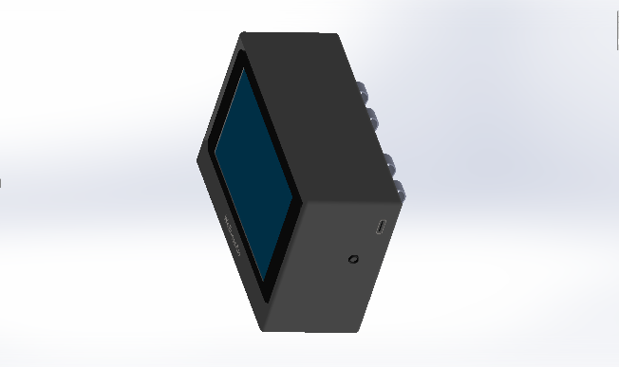
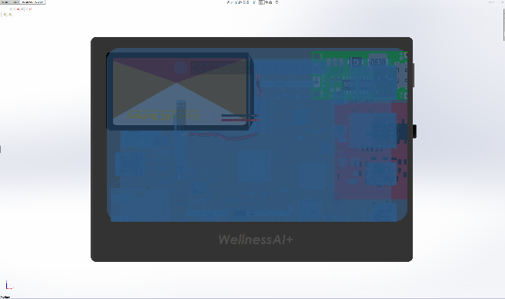
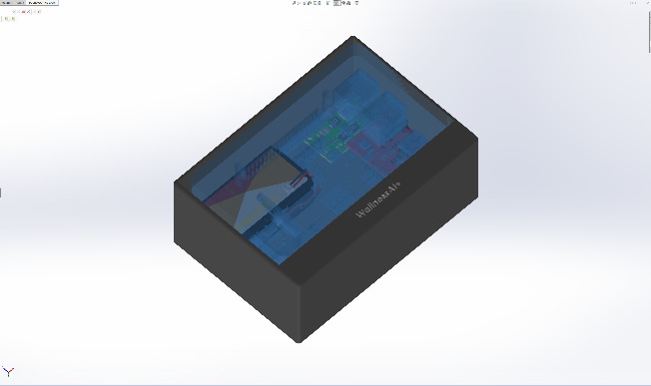
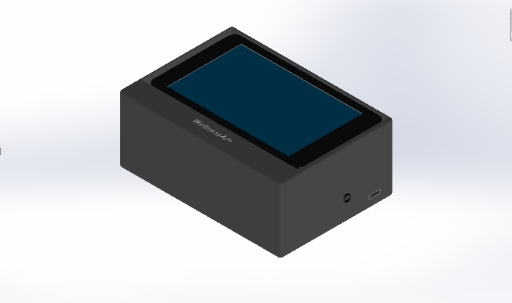

Wearable Design – Clip on Pants

Slide 20


Initial Idea – Emotion Recognition
CNN
Image data
Use a combined dataset
(WESAD, AMIGOS, DREAMER, DEAP)
Fine tune model to deploy
https://www.eecs.qmul.ac.uk/mmv/datasets/amigos/download.html
https://zenodo.org/records/546113#.YKLY0WYzaHs
https://zenodo.org/records/546113#.YKLY0WYzaHs
https://archive.ics.uci.edu/dataset/465/wesad+wearable+stress+and+affect+detection

Slide 21


Initial Idea – Emotion Recognition

Slide 22


Initial Idea – Emotion Recognition

Slide 23

Emotion Recognition
Sequential Neural Network
Raw 16-bit data
1 seconds frame (approximately 500Hz)
WESAD dataset
Build everything from scratch

Slide 24





WESAD Dataset

Slide 25

Dataset Validation before Preprocessing

Slide 26


Dataset Preprocessing
import pickle
import pandas as pd
import numpy as np
# Load data from the pickle file
with open("data_preprocessing\\pkl_data\\S17.pkl", "rb") as file:
obj = pickle.load(file, encoding="latin1")
# Extract 'label' and 'ECG' arrays
label_data = obj['label']
ecg_data = obj['signal']['chest']['ECG']
# Create a DataFrame with 'label' and 'ECG' columns
df = pd.DataFrame({'label': label_data.flatten(), 'ECG': ecg_data.flatten()})
# Filter out rows where the label is 1, 5, 6, or 7
filtered_df = df[~df['label'].isin([0, 5, 6, 7])].copy() # Make a copy to avoid SettingWithCopyWarning
# Create a '16-bit' column based on the modified formula using .loc
filtered_df.loc[:, '16-bit'] = ((filtered_df['ECG'] / 3) + 0.5) * (2 ** 16)
# Reshape 'label' and '16-bit' arrays to have the same number of rows
num_rows = len(filtered_df) // 7000 * 7000
label_data = filtered_df['label'][:num_rows].values.reshape((-1, 7000))
bit16_data = filtered_df['16-bit'][:num_rows].values.reshape((-1, 7000))
# Identify rows where labels differ within the 7000 readings and discard those rows
valid_rows_mask = (label_data == label_data[:, [0]]).all(axis=1)
label_data = label_data[valid_rows_mask]
bit16_data = bit16_data[valid_rows_mask]
# Create a DataFrame with transposed '16-bit' data
final_df = pd.DataFrame(np.hstack((bit16_data, label_data[:, 0].reshape(-1, 1))), columns=[f'data{i+1}' for i in range(7000)] + ['label'])
# Save the final DataFrame to CSV
final_df.to_csv("data_preprocessing\\output_filter_label\\output_S17.csv", index=False)
16-bit ECG
Last Col: Label

Slide 27

Dataset Validation after Preprocessing

Slide 28

Dataset Validation after Preprocessing
https://colab.research.google.com/drive/1GXLzKMqylWgAKi7cYG9Fpy2-18rGqPAd#scrollTo=QM67ZIECR2rb

Slide 29


Model Result – Overfits!

Slide 30

Conversion of TensorFlow to TFLite

Slide 31

X-Cube-AI Installation

Slide 32

X-Cube-AI Installation

Slide 33


Flash memory not enough!

Slide 34


Fine tuning…

Slide 35
Complexity Reduction!
Initial Output Overfits:
Reduce to stress & non-stress classification (2 output classification)
Reduce to 5000 inputs (approx. 500Hz)
Restart the whole process from data preprocessing

Slide 36


Complexity Reduction!
Less Overfits:

Slide 37

Enough Flash & RAM after Medium compression!

Slide 38

Setup model in ARM Cortex-M4

Slide 39


Library Depreciated

Slide 40

Solution
https://wiki.st.com/stm32mcu/wiki/AI:How_to_perform_motion_sensing_on_STM32L4_IoTnode

Slide 41

Debugging…

Slide 42


Solution

Slide 43

Solution

Slide 44

Success!

Slide 45


What’s Next?

